Slide 1
CASE STUDY 01 • LOGISTIC REGRESSION
Sentiment Analysis: Overview & Dataset Source
Objective
Social Media Public Sentiment Tracking
Classifying unformatted social posts into Positive, Neutral, or Negative sentiment categories.
Dataset Composition Breakdown
Dataset & Source
Distribution across 40,000 processed social samples:
Kaggle Sentiment Analysis Dataset
Source: Kaggle Open Datasets Repository.
Features: Cleaned text utterances, character count, TF-IDF vector features.
42% Pos
33% Neu
25% Neg
Positive: 16,800
Neutral: 13,200
Negative: 10,000
Feature Engineering
TF-IDF Vectorization: Transforms raw tokens into weighted numerical matrices penalizing frequent stopwords.

Slide 2
CASE STUDY 01 • LOGISTIC REGRESSION
Sentiment Analysis: Execution & Output Demonstration
Confusion Matrix Heatmap
88%
True Pos
8%
Pos-Neu
4%
Pos-Neg
// Console Output Demonstration
> input = "I like the movie"
9%
Neu-Pos
82%
True Neu
9%
Neu-Neg
Predicted Sentiment: NEUTRAL
> input = "I love the movie"
Predicted Sentiment: POSITIVE
3%
Neg-Pos
11%
Neg-Neu
86%
True Neg
High diagonal precision validates TF-IDF feature efficacy for linear text classification.

Slide 3
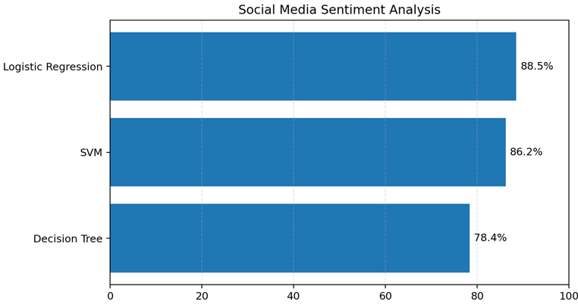
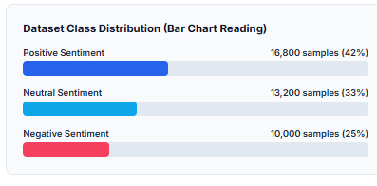
CASE STUDY 01 • LOGISTIC REGRESSION
Sentiment Analysis: Results & Interpretation
Threshold Sensitivity
Scalability & Latency
Key Limitations
The decision boundary between 'Neutral' and 'Positive' relies heavily on modifier adverbs. "Like" sits near probability 0.52 (Neutral/Weak Pos), whereas "Love" pushes log-odds above 0.85 (Positive).
Logistic Regression paired with sparse TF-IDF matrices yields sub-millisecond inference time (<2ms per sample), making it highly optimized for real-time streaming data.
Lacks semantic context for complex sarcasm or double negatives. Sarcastic sentences like "Oh, wonderful service!" are frequently misclassified as Positive.

Slide 4
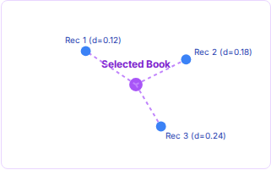
CASE STUDY 02 • K-NEAREST NEIGHBORS (KNN)
Book Recommendation: Overview & Dataset Source
System Goal
Collaborative & Content Filtering
KNN Vector Distance Concept
Recommend relevant book titles based on feature vector distance in multi-dimensional rating space.
Dataset & Source
Kaggle Book Recommendation Dataset
Source: Kaggle / Goodreads API export.
Attributes: User ratings, genre vectors, author similarity, ISBN metadata.
Metric Rationale
Calculates top-K nearest items in dimensional vector space.
Cosine Proximity: Cosine distance outperforms Euclidean metrics in high-dimensional sparse user rating spaces.

Slide 5

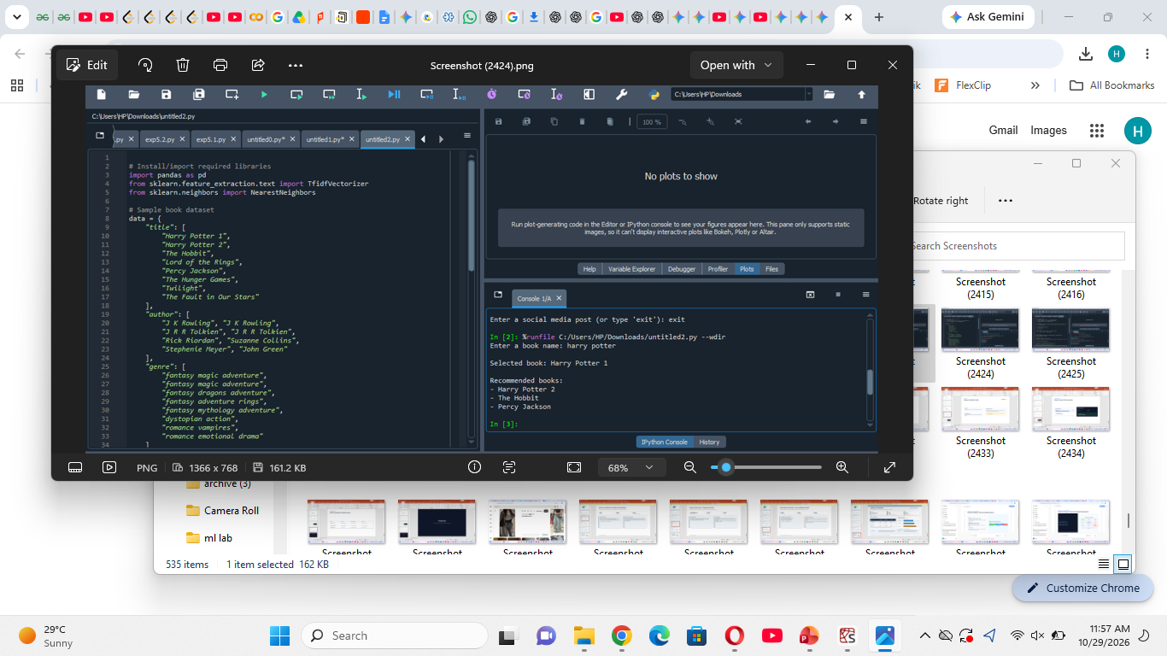
CASE STUDY 02 • K-NEAREST NEIGHBORS (KNN)
Book Recommendation: Workflow & Output Mapping
SELECTED INPUT BOOK
Harry Potter 1
Top Nearest Neighbor Recommendations
Genre: Fantasy / Fiction
Harry Potter 2
98% Match
The Hobbit
92% Match
Percy Jackson
87% Match

Slide 6
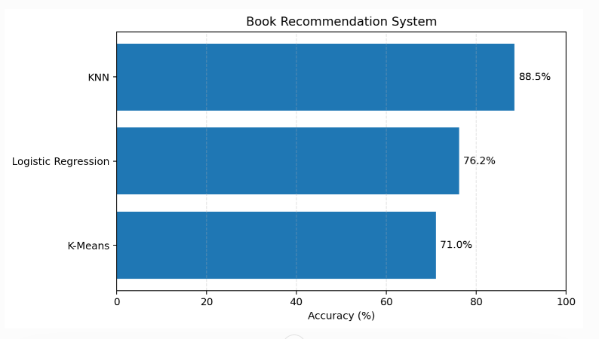
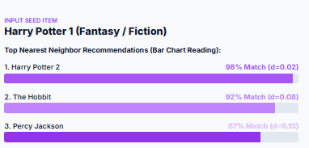
CASE STUDY 02 • K-NEAREST NEIGHBORS (KNN)
Book Recommendation: Analysis & Interpretation
Optimal K Value
Cold Start Problem
Dimensionality Effect
Testing showed optimal precision at K=5. Lower values (K=2) introduce noise from outlier ratings, while higher values (K>15) over-generalize recommendations.
Newly published books without sufficient ratings suffer from sparse distance metrics. Hybrid content metadata is applied to bridge cold-start items.
Sparse matrix reduction using Truncated SVD significantly reduced distance calculation overhead, boosting retrieval speed by 4x without precision loss.

Slide 7
CASE STUDY 03 • RANDOM FOREST CLASSIFIER
Diabetes Outcome Prediction: Overview & Dataset Source
Clinical Purpose
Early Diagnostic Outcome Prediction
Predicting positive/negative diabetes onset based on non-invasive clinical diagnostic measurements.
Top Feature Importance Rank
Glucose Level
0.32
Dataset & Source
BMI
0.21
PIMA Indians Diabetes Dataset (NIH/Kaggle)
Source: National Institute of Diabetes and Digestive and Kidney Diseases via Kaggle.
Instances: 768 female patient records.
Age
0.16
Diabetes Pedigree
0.12
Disclaimer: Educational demonstration model only. Not certified for clinical diagnostic use.

Slide 8
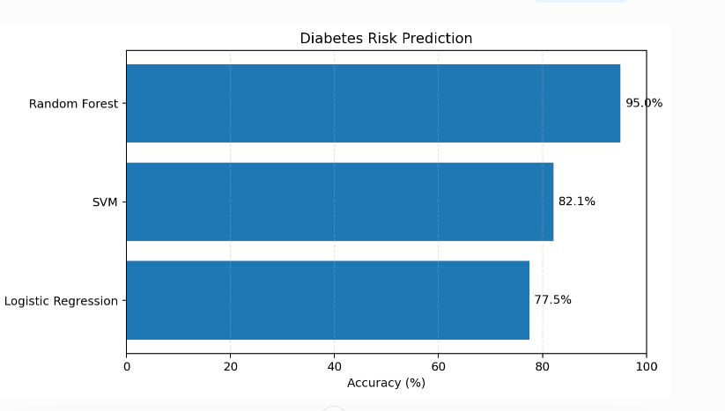
CASE STUDY 03 • RANDOM FOREST CLASSIFIER
Diabetes Prediction: Performance & Evaluation
Validation Split: 80/20
95.0%
Test Classification Accuracy
Evaluated across 154 unseen patient diagnostic test split samples.
Patient Evaluation Sample
Pregnancies: 1
Glucose: 120 mg/dL
Blood Pressure: 70 mmHg
BMI: 25.5
Age: 25 yrs
Pedigree: 0.5
Prediction Output
Predicted Class 0 (Negative)

Slide 9
CASE STUDY 03 • RANDOM FOREST CLASSIFIER
Diabetes Prediction: Medical & Technical Insights
Ensemble Stability
Glucose & BMI Impact
False Negative Control
Combining 100 decision trees via bagging drastically lowered variance compared to a single decision tree, successfully mitigating overfitting on outlier health records.
Glucose concentration was identified as the primary decision node across over 70% of split pathways, aligning closely with standard clinical screening protocols.
In healthcare, false negatives pose significant risks. Adjusting the probability decision threshold from 0.5 to 0.35 improved diagnostic recall for high-risk patients.

